Slide 1


Kinnari Janakbhai Patel, Srivardhan Ranga, Corey Slayton, Paul Tamayo, Frantz-Michel Bataille, Joseph Camacho
Group 2 Presentation
ISM6205- Database Management

Slide 2


CANARY AUTO PARTS
CONTENTS
Meet the Team ……………………………………………..………………………………............................................................... 3
Introduction (CARS4ALL) ……………………………………………..…………………………………………………………………………………......... 4
Business Features ……………………………………………..……………………………………………............................................. 6
Business Rules ……………………………………………..………………………………………………........................................... 7
ER Diagram .………………………………………………..…………………………………....................................................... 8
Application UI Design Screens …………………………….................................................................................................................. 9
SQL Queries for Screens (APEX) ….…………………............................................................................................................ 12
Conclusion ……………………………………………………………………………………………………………………………………………….15
Oracle APEX Demo ……………………………………………………………………………………………………………………………………………….17

Slide 3


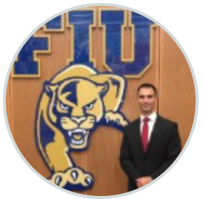

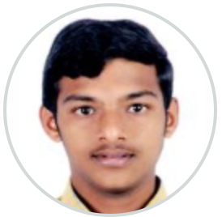

PROJECT CARS4ALL : MEET THE TEAM
Team Canary
Frantz-Michel Bataille
Team Lead
Paul Tamayo
Design Lead
Corey Slayton
Design Lead
Application Design Lead
Tester
Kinnari Janakbhai Patel
Application Design Lead
Tester
Srivardhan Ranga
Application Design Lead
SQL Guru
Joseph Camacho
SQL Guru

Slide 4
PROJECT : CARS4ALL
INTRODUCTION
Canary Auto Parts is a premium new database service for several small auto repair shops and vendors in United States.
It is a subscription-based platform that generates revenue by connecting Customers and Vendors seamlessly
Several business problems developed within the company’s value chain due to their inability to analyze and manage their capital resources effectively because the business did not have any Online Transaction Processing (OTLP) System.

Slide 5

MAIN FOCUS: Online Transaction Processing System
SOLUTION FOR CANARY AUTO PARTS
Improve Quality
Management
Increase Analytical ability
OLTP System
Reduce resources required for Sales
Increase Forecasting ability

Slide 6
FEATURES OFFERED BY CanaryAuto Database
Important Business Features
Customers will be able to purchase specific parts for specific brand and car (make/model) from multiple vendors & check the availability of the part they are looking for
Vendors will be able to post all their stock that’s available for repairs shops to able to select from
CanaryAuto database moving into the Oracle cloud will increase its performance and enable more Repair Shops and Vendors to connect easily through an APEX application
Application usage data can be captured and analyzed to provide insight on Repair Shops and Vendors
Data captured can be transformed into business intelligence
Business intelligence enables managers to make data driven decisions increasing operational efficiency

Slide 7
CANARY AUTO PARTS
Most Important Business Rules
Repair Shops and Vendors are constrained to the United States only.
For security purposes, when the repair shop is deleted, all their saved credit card information should also be deleted.
If a cart is deleted all the items associated with that cart should also be deleted.
When a vendor is deleted from the system, all the stock listed by that vendor should also be deleted.
Vendor must have Cart Items “In-Stock” to place in cart
If a part is in stock, it cannot be deleted from the parts catalog.
Once all items are selected, repair shops can place an order for the auto parts in the cart
Cart Items are restricted to Parts

Slide 8
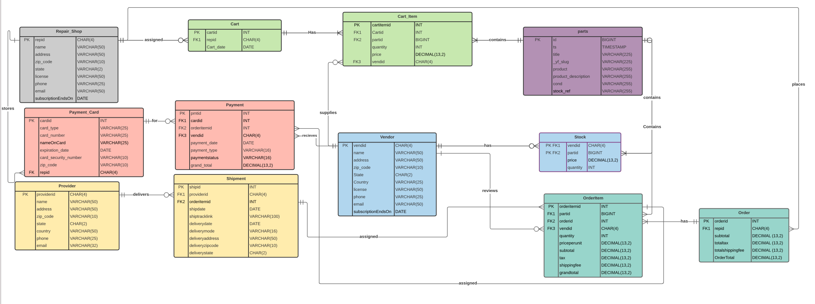
CANARY AUTO PARTS : ER Model
ER Model

Slide 9
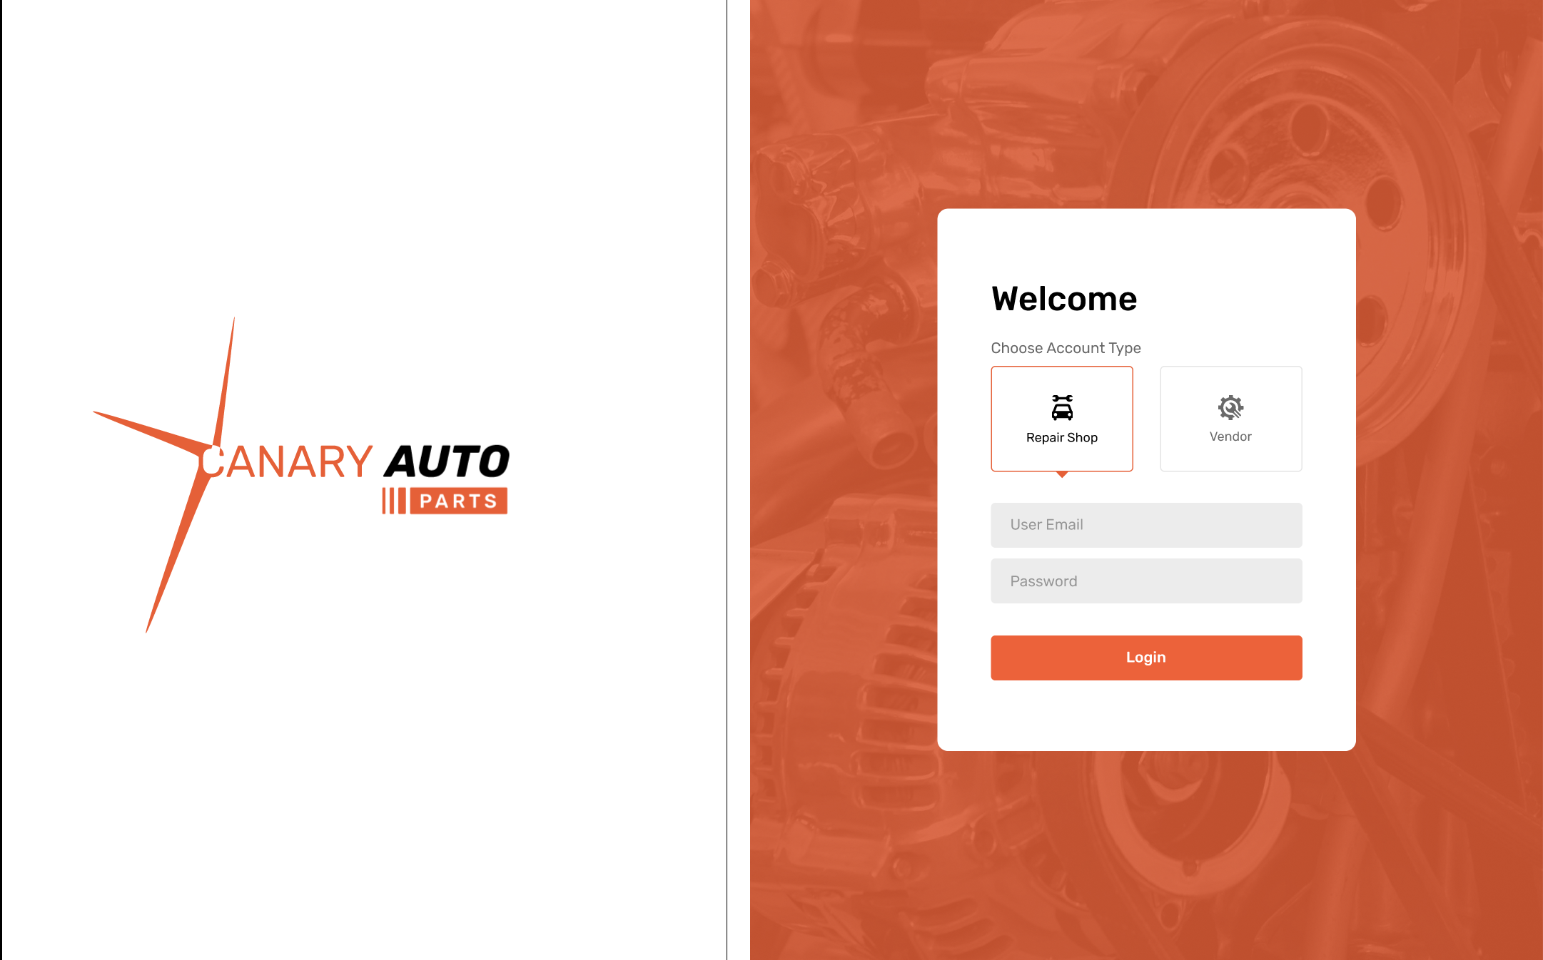
CANARY AUTO PARTS : Login Screen Design
LOGIN

Slide 10
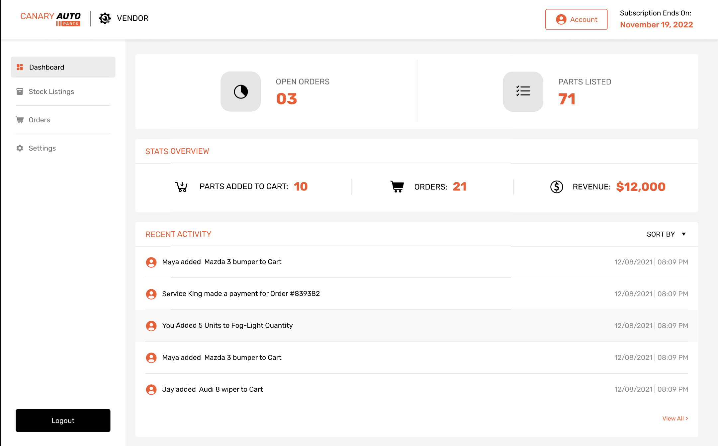
CANARY AUTO PARTS : Vendor Screen Design
VENDOR

Slide 11
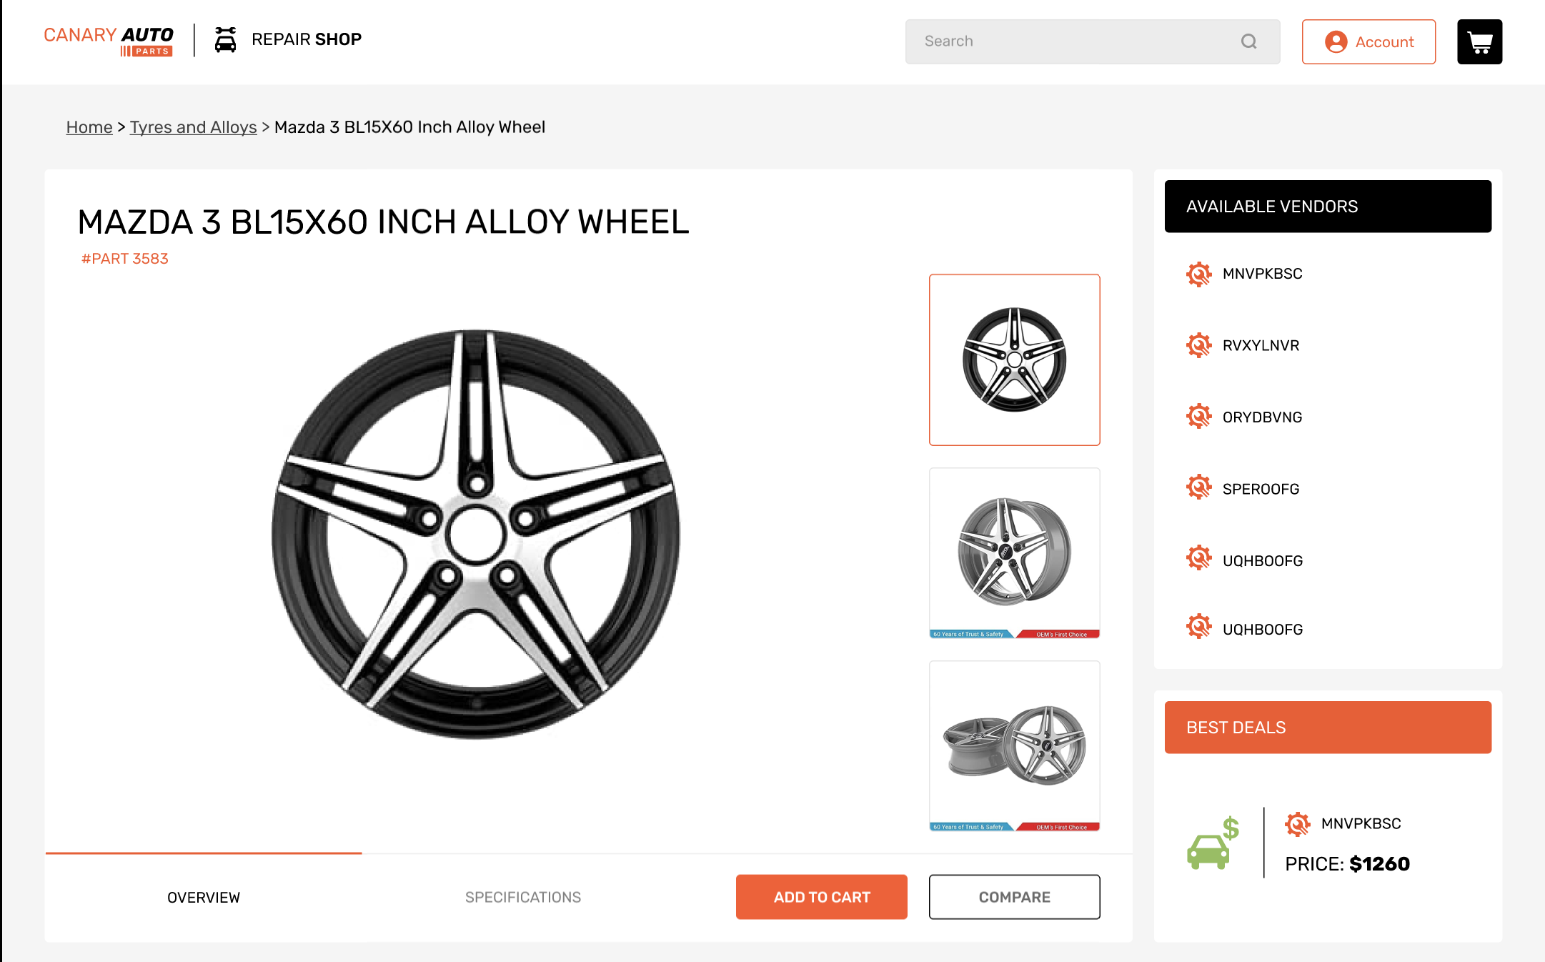
CANARY AUTO PARTS : Repair Shop Screen Design
REPAIR SHOP

Slide 12
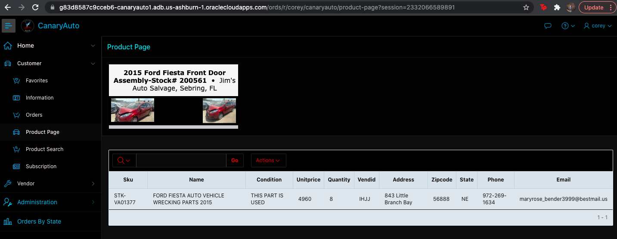
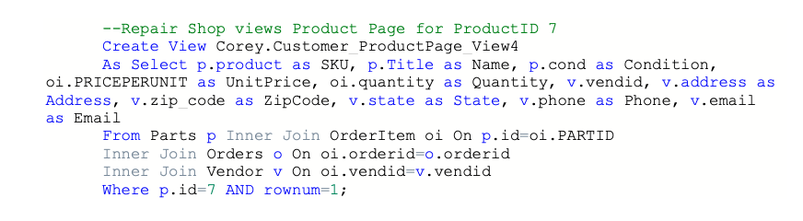
CANARY AUTO PARTS : SQL Queries (APEX)
Product Page:

Slide 13
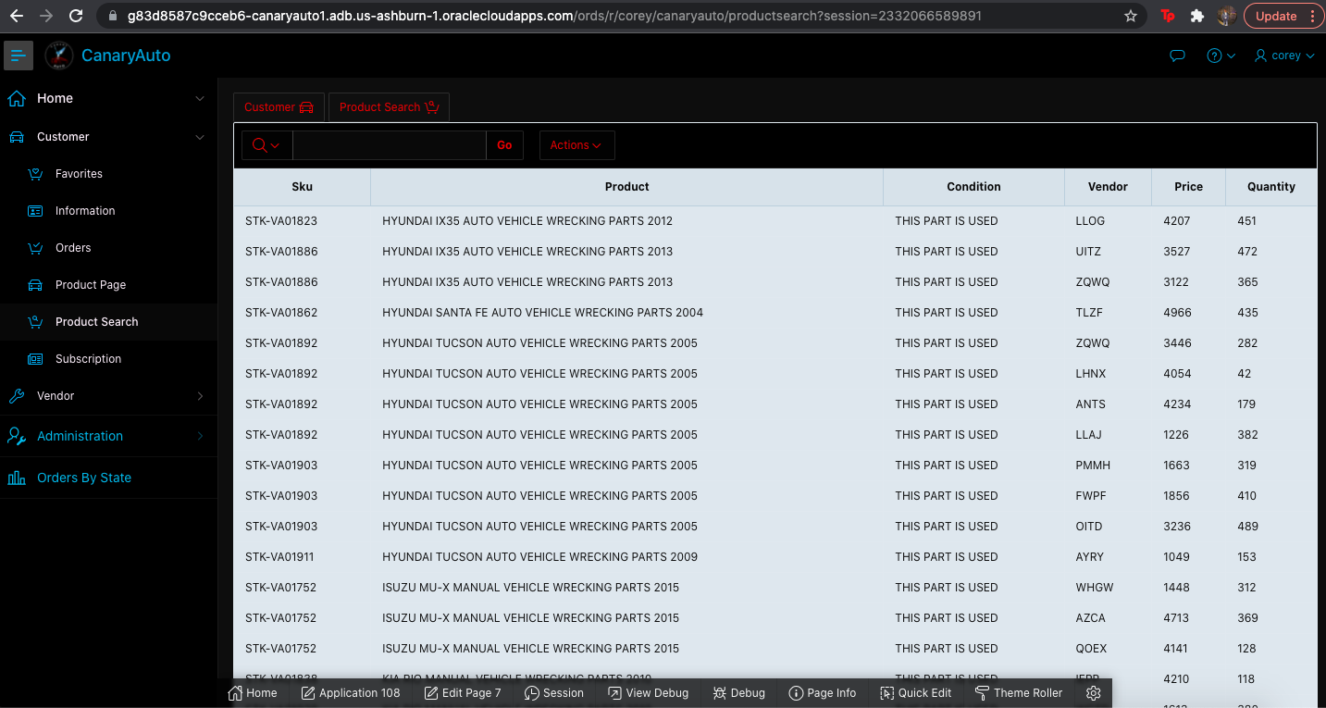
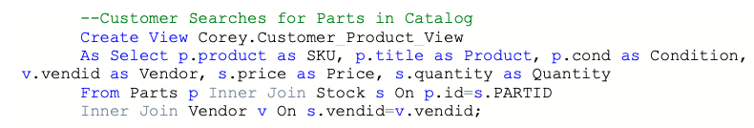
CANARY AUTO PARTS : SQL Queries (APEX)
Product Search Page:

Slide 14
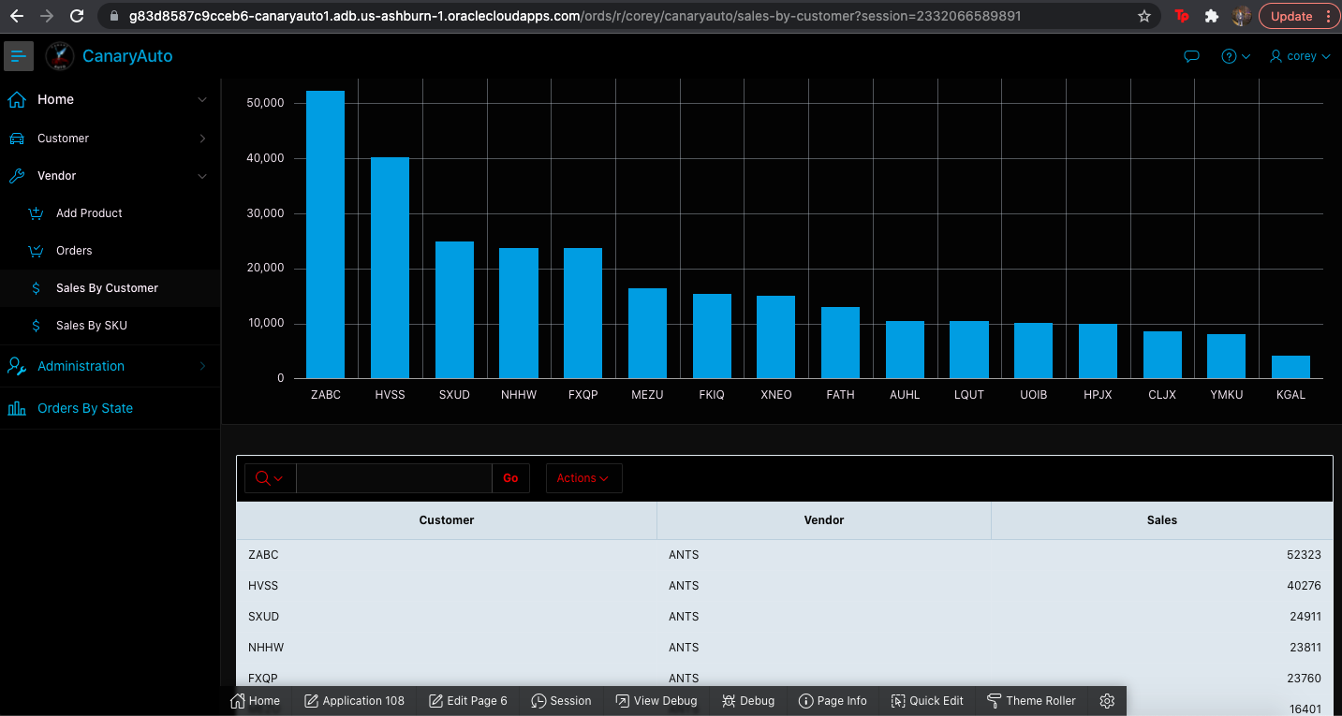
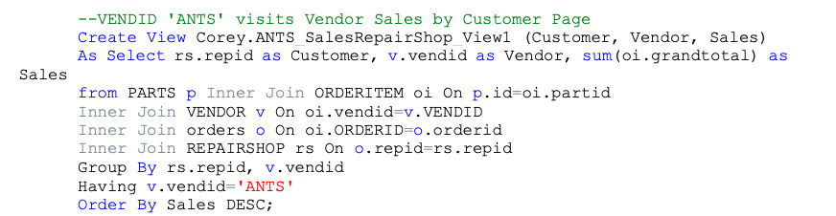
CANARY AUTO PARTS : SQL Queries (APEX)
Vendor Sales by Customer Page:

Slide 15
Conclusion
Lessons Learned
Learned the skills required to design and create a database according to business rules and need for referential integrity
Improved teamwork skills required to translate database from MySQL to Oracle DBMS
Gained some application development skills which are required to connect many users to our database and provide as much business value added as possible
Developed our ability to think critically as a team through the complex problems required for IT project success

Slide 16
Conclusion
Lessons Learned
Using the INNER JOIN syntax allowed the project to achieve its first goal allowing all matching data to be presented seamlessly and provide thorough information
DATEDIFF can be used for integrating a subscription system by providing days till a subscription renews
Indexes coupled with views, allow for faster response times from the queried data base
A cloud database was eventually needed forcing the need for all syntax to be compatible with IDEs that function with cloud databases (ie Oracle)
The amount of complex queries must be reduced in order to decrease the possibility of errors, accomplishing goal two.

Slide 17
Conclusion: Screen Demos
Links to Access the Screens
UI Screens Designs: Canary Auto Parts (Screen Designs)
Oracle APEX implementation: Canary Auto Parts (Oracle APEX)
User: Corey
Password: CanaryAuto21

Slide 18
THANK YOU
-Team Canary

